Slide 1
UNIT IV
Nearest Neighbour Classifiers - Characteristics
Navie Bayes Classifier – Theory, formula and problems
Logistic Regression – as Linear Regression, model parameters, and its characteristics
Ensemble Methods – Methods for constructing ensemble classifier, Bagging, Boosting and Random Forests.

Slide 2
Types of Classifiers
Binary versus Multiclass
Binary classifiers assign each data instance to one of two possible labels, typically denoted as +1 and −1.
The positive class usually refers to the category we are more interested in predicting correctly compared to the negative class (e.g., the spam category in email classification problems).
If there are more than two possible labels available, then the technique is known as a multiclass classifier.
For example, in the case of identification of different types of fruits, “Shape”, “Color”, “Radius” can be featured, and “Apple”, “Orange”, “Banana” can be different class labels.

Slide 3
Types of Classifiers
Deterministic versus Probabilistic (weather forecasting)
A deterministic classifier produces a discrete-valued label to each data instance it classifies (consistent, accurate and precise)
probabilistic classifier assigns a continuous score between 0 and 1 to indicate how likely it is that an instance belongs to a particular class, where the probability scores for all the classes sum up to 1.
Linear versus Nonlinear
A linear classifier uses a linear separating hyperplane to discriminate instances from different classes whereas a nonlinear classifier enables the construction of more complex, nonlinear decision surfaces

Slide 4
Types of Classifiers
Global versus Local
A global classifier fits a single model to the entire data set.
Unless the model is highly nonlinear, this one-size-fits-all strategy may not be effective when the relationship between the attributes and the class labels varies over the input space.
In contrast, a local classifier partitions the input space into smaller regions and fits a distinct model to training instances in each region.
While local classifiers are more flexible in terms of fitting complex decision boundaries, they are also more susceptible to the model overfitting problem, especially when the local regions contain few training examples

Slide 5
KNN - K Nearest Neighbors
In a single sentence, nearest neighbor classifiers are defined by their characteristic of classifying unlabeled examples by assigning them the class of the most similar labeled examples.
Powerful classification algorithm - pattern recognition.
Computer vision applications, including optical character recognition and facial recognition in both images and video.
Predicting whether a person enjoys a movie which he/she has been recommended (as in the Netflix challenge)
Identifying patterns in genetic data, for use in detecting specific protein or diseases
An object (instance) is classified by the majority votes, for its neighbor classes

Slide 6
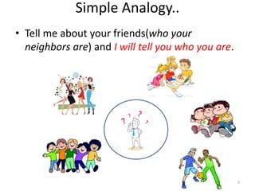
KNN

Slide 7
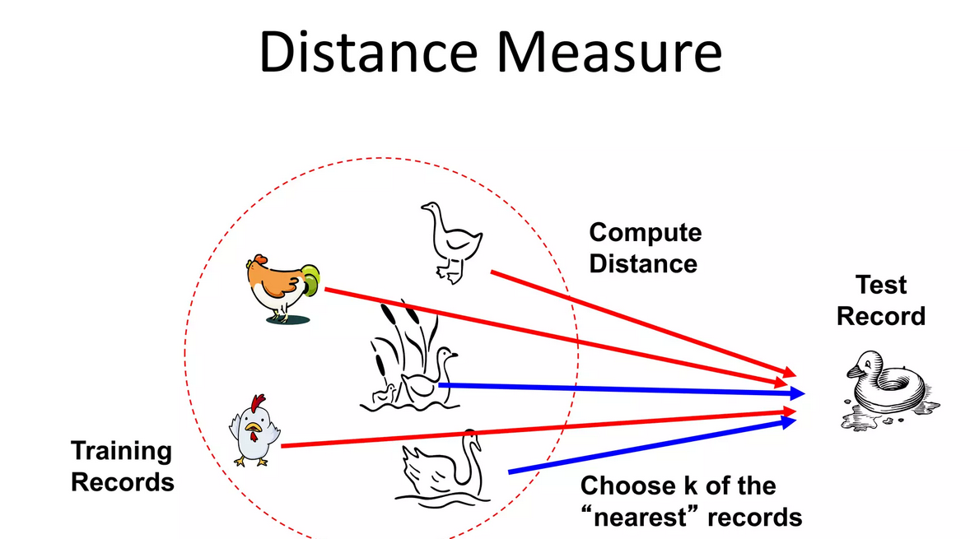
KNN

Slide 8
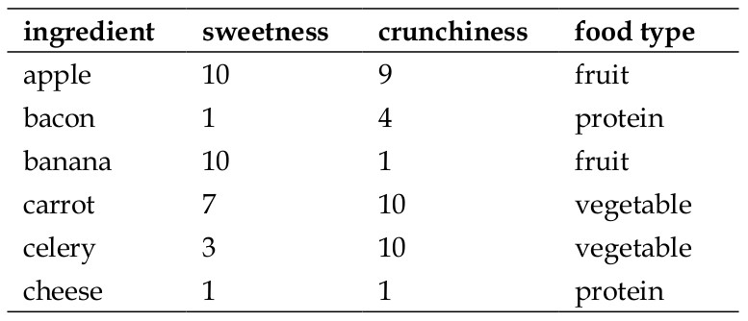
KNN

Slide 9
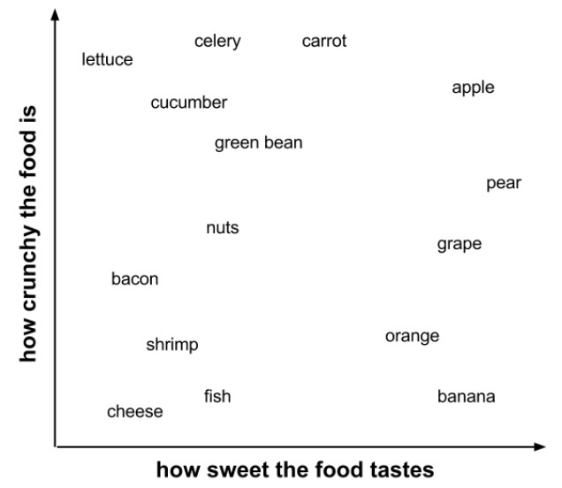
KNN

Slide 10
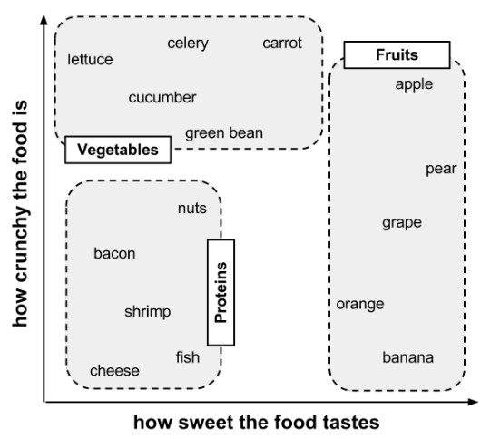
KNN

Slide 11
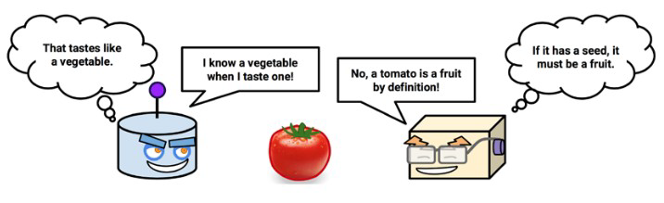
KNN - Calculating distance

Slide 12
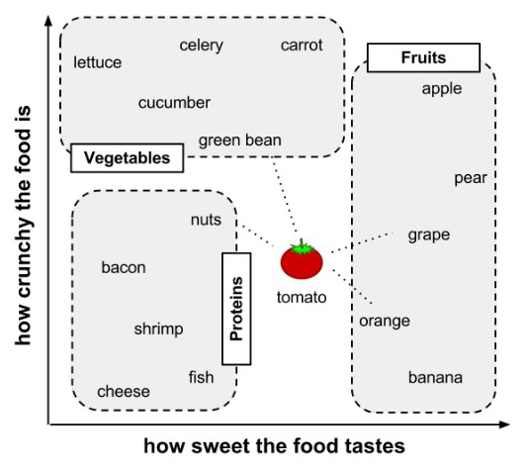
KNN - Calculating distance

Slide 13
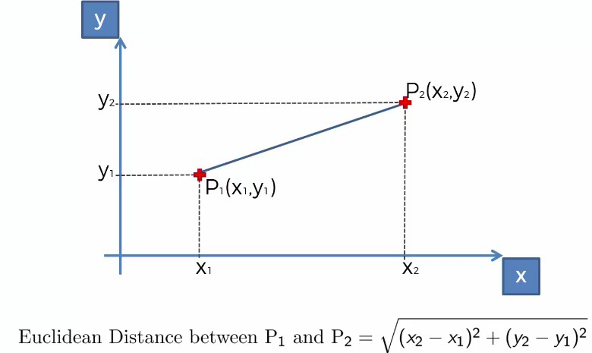
KNN - Calculating distance
Locating the tomato's nearest neighbors requires a distance function, or a formula that measures the similarity between two instances.
There are many different ways to calculate distance.
Traditionally, the kNN algorithm uses Euclidean distance,which is the distance one would measure if you could use a ruler to connect two points, illustrated in the previous figure by the dotted lines connecting the tomato to its neighbors.

Slide 14
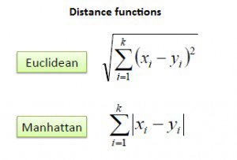

KNN - Calculating distance
The distance formula involves comparing the values of each feature. For example, to calculate the distance between the tomato (sweetness = 6, crunchiness = 4), and the green bean (sweetness = 3, crunchiness = 7), we can use the formula as follows:

Slide 15
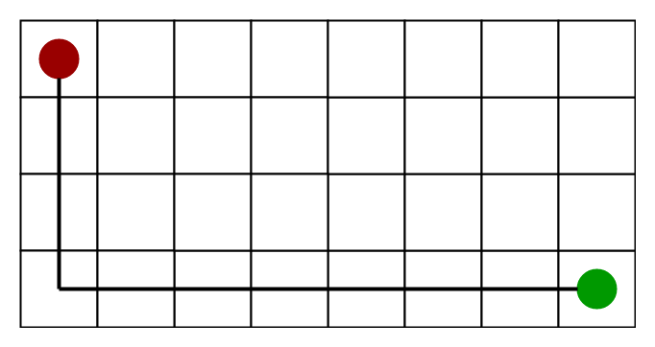
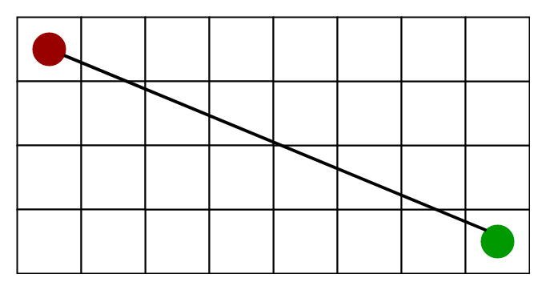
KNN - Calculating distance
Manhattan distance
Euclidean distance

Slide 16
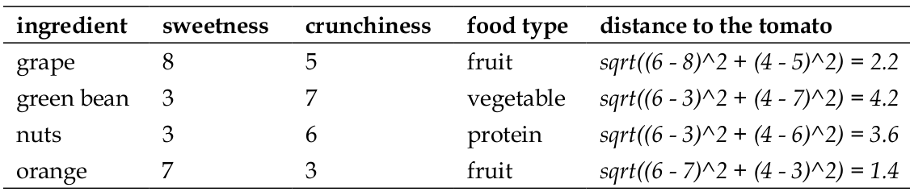
KNN - Calculating distance

Slide 17
Step #1 - Assign a value to K. Step #2 - Calculate the distance between the new data entry and all other existing data entries (you'll learn how to do this shortly). Arrange them in ascending order. Step #3 - Find the K nearest neighbors to the new entry based on the calculated distances. Step #4 - Assign the new data entry to the majority class in the nearest neighbors.

Slide 18
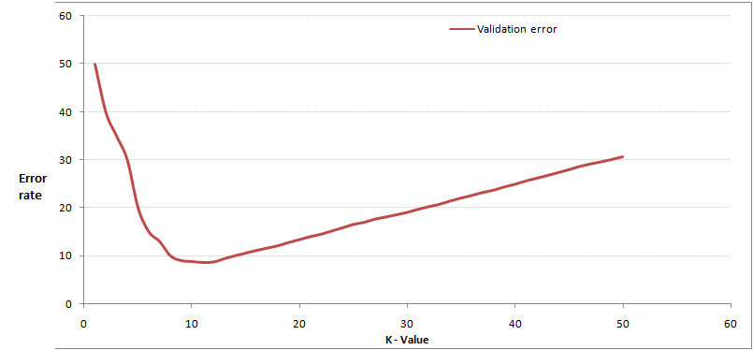
KNN - Choosing appropriate k
Deciding how many neighbors to use for kNN determines how well the mode will generalize to future data.
Choosing a large k reduces the impact or variance caused by noisy data, but can bias the learner such that it runs the risk of ignoring small, but important patterns.

Slide 19
KNN - Choosing appropriate k
In practice, choosing k depends on the difficulty of the concept to be learned and the number of records in the training data.
Typically, k is set somewhere between 3 and 10.
One common practice is to set k equal to the square root of the number of training examples.
In the classifier, we might set k = 4, because there were 15 example ingredients in the training data and the square root of 15 is 3.87.

Slide 20
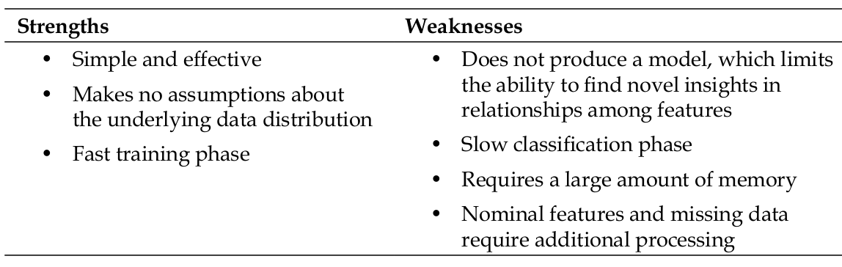
KNN - Strengths and weaknesses

Slide 21
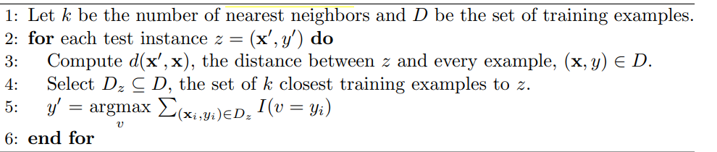
Algorithm – K nearest Neighbour

Slide 22
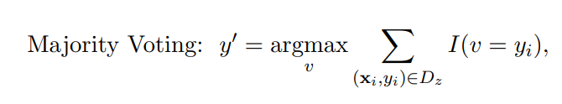
How to Determine the class label of a Test Sample?
Once the nearest neighbor list is obtained, the test instance is classified based on the majority class of its nearest neighbors:
where v is a class label, yi is the class label for one of the nearest neighbors, and I(·) is an indicator function that returns the value 1 if its argument is true and 0 otherwise.

Slide 23
Characteristics of Nearest Neighbour
Instance based learning: It needs specific training instances to create predictions without having to support an abstraction (or model) derived from data.
Lazy learners (KNN) doesn’t need model building – defining test examples is enough
Require a proximity measure to determine the similarity or distance between instances
Requires classification function that returns the predicted class of a test instance based on its proximity to other instances
Classifying a test instance can be quite expensive because we need to compute the proximity values individually between the test and training examples.

Slide 24
Characteristics of Nearest Neighbour
Nearest neighbor classifiers make their predictions based on local information
Produces decision boundaries of arbitrary shape.
The decision boundaries have high variability because they depend on the composition of training examples in the local neighborhood.
Increasing the number of nearest neighbors may reduce such variability.
Have difficulty handling missing values in both the training and test sets since proximity computations normally require the presence of all attributes

Slide 25
Characteristics of Nearest Neighbour
The presence of irrelevant attributes (adds noise) can distort commonly used proximity measures, especially when the number of irrelevant attributes is large
A large number of redundant attributes that are highly correlated with each other, then the proximity measure can be overly biased toward such attributes, resulting in improper estimates of distance.
Can produce wrong predictions unless the appropriate proximity measure and data preprocessing steps are taken

Slide 26
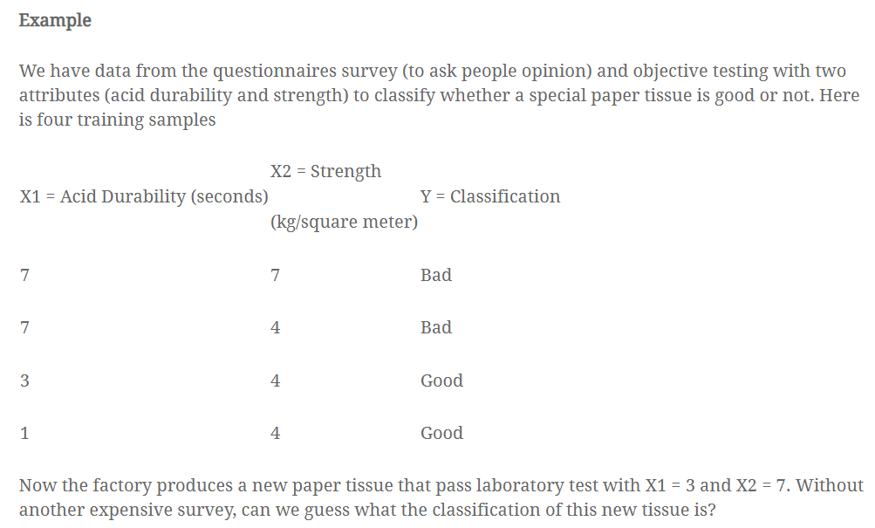
KNN - Example numericals

Slide 27
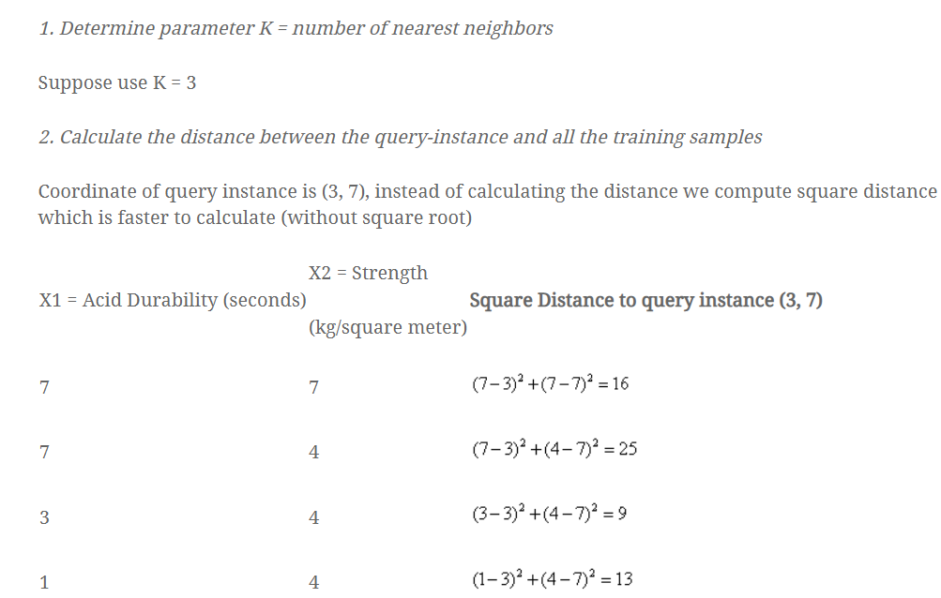
KNN - Example numericals

Slide 28
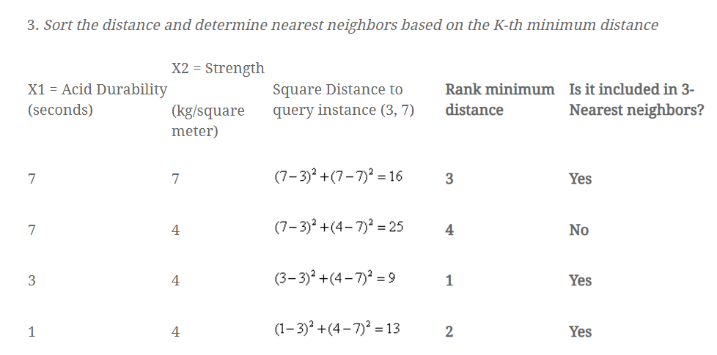
KNN - Example numericals

Slide 29
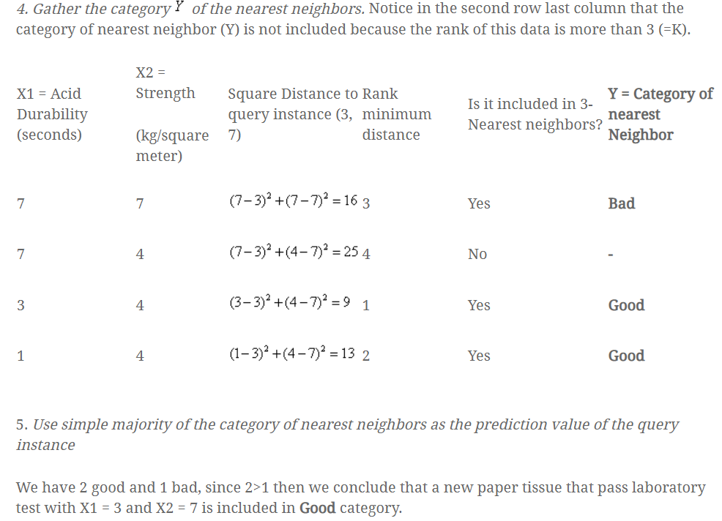
KNN - Example numericals

Slide 30
KNN
Why the kNNalgorithm is called a lazy learner?
Eager learners follow the general steps of machine learning, i.e. perform an abstraction of the information obtained from the input data and then follow it through by a generalization step.
However, as we have seen in the case of the kNNalgorithm, these steps are completely skipped.
It stores the training data and directly applies the philosophy of nearest neighbourhood finding to arrive at the classification.
So, for kNN, there is no learning happening in the real sense. Therefore, kNN falls under the category of lazy learner.

Slide 31

Naive Bayes Classifier
$$p_{1}$$

Slide 32
Basics of Probability Theory
Probability theory field of mathematics and statistics – concerned with finding the probabilities associated with random events.
Random event: an event that occurs and will have several outcomes.
Ex: Flip a coin – {Tails, Head} Roll the dice – {1,2,3,4,5,6}
Probability theory – 1. Random Variable and 2. Probability distributions
Probability distributions: Number of favorable outcomes / Total no:of possible outcomes of an event. (Ex: When u roll a dice : u get favorable outcome as 1 , further, possible outcomes are {1,2,3,4,5,6})
So probability of occurring 3 is = 1/6 = 0.167

Slide 33
Basics of Probability Theory-- Terminologies
Example: Let’s take two random dice and roll them randomly, now the
probability of getting a total of 10 is calculated.
Solution:
Total Possible events that can occur (sample space) {(1,1), (1,2),…, (1,6),…, (6,6)}. The total spaces are 36.
Now the required events, {(4,6), (5,5), (6,4)} are all which adds up to 10.
So the probability of getting a total of 10 is = 3/36 = 1/12

Slide 34
Basics of Probability Theory-- Terminologies
Random Experiment: trial that is repeated multiple times in order to get a well-defined set of possible outcomes.(Tossing a coin)
A random experiment is a physical situation whose outcome cannot be predicted until it is observed.
Sample Space: set of all possible outcomes that result from conducting a random experiment.
For example, the sample space of tossing a fair coin is {heads, tails}.
Event: set of outcomes of an experiment that forms a subset of the sample space.
Types:
Independent events
Dependent events
Mutually exclusive
Equally likely

Slide 35
Basics of Probability Theory-- Terminologies
Independent Events: The events whose outcomes are not affected by the outcomes of other future and/or past events are called independent events.
For example, the output of tossing a coin in repetition is not affected by its previous outcome.
Dependent Events: The events whose outcomes are affected by the outcome of other events are called dependent events.
For example, picking oranges from a bag that contains 100 oranges without replacement.
Mutually Exclusive Events: The events that can not occur simultaneously are called mutually exclusive events.
For example, obtaining a head or a tail in tossing a coin, because both (head and tail) can not be obtained together.
Equally likely Events: The events that have an equal chance or probability of happening are known as equally likely events.
For example, observing any face in rolling dice has an equal probability of 1/6.

Slide 36
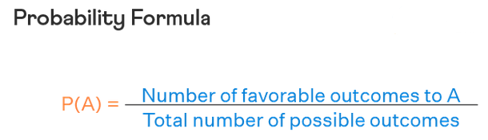
Basics of Probability Theory
Random Variables: A random variable is a variable whose possible values are numerical outcomes of a random experiment.
There are two types of random variables:
Discrete random variable: This is a variable that may take on only a countable number of distinct values, such as zero, one, two, three, four, etc.
Continuous random variable: This is a variable that takes an infinite number of possible values. Continuous random variables are usually measurements.

Slide 37
Basics of Probability Theory
Probability simply talks about how likely is the event to occur, and its value always lies between 0 and 1
Further, the sum of probability values of all possible events, e.g., outcomes of a variable X is equal to 1.
Random variables - variable whose possible values are numerical outcomes of a random phenomenon.
For example: consider that you have two bags, named A and B, each containing 10 red balls and 10 black balls.
In the above case, Bag is a random variable that can take possible values as Bag A and Bag B. Ball is also a random variable that can take values red and black.

Slide 38

Basics of Probability Theory
Now, let us consider two random variables, X and Y , that can each take k discrete values.
Let nij be the number of times we observe X = xi and Y = yj , out of a total number of N occurrences.
The joint probability of observing X = xi and Y = yj together can be estimated as
Joint probabilités are symmetric, i.e., P(X = x, Y = y) = P(Y = y,X = x)

Slide 39
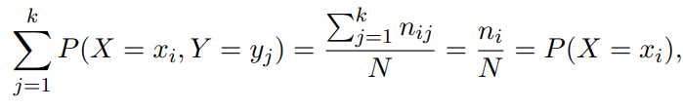
Basics of Probability Theory
For joint probabilities, it is to useful to consider their sum with respect to one of the random variables,
Now imagine the above situation when I say find the probability that ball is drawn from a bag A given that the ball is red in color?
Notice that in this question we’re already given the color of the ball and we’ve to find the probability that the red ball is drawn is from bag A. Instead in other questions we used to find the probability of drawing a red ball from bag A

Slide 40
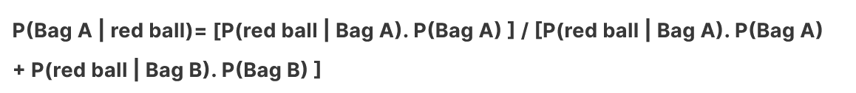
Basics of Probability Theory
In the case where we’ve to find the probability of event and object is given, this kind of probability is called posterior probability.
In the case where we’ve to find the probability of an object given for that event, this kind of probability is known as the prior probability.
The above equation is what we call “Bayes Theorem”

Slide 41
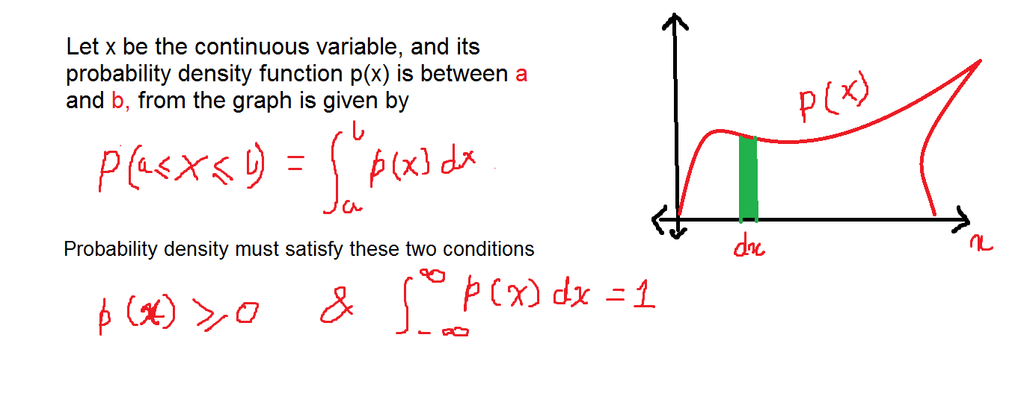
Basics of Probability Theory
Till now, we were considering the probabilities of discrete events but our requirement is for continuous events - “Probability Density”

Slide 42
Basics of Probability Theory
How does it relate to Machine learning??
Consider a case where we’ve got a dataset for different temperatures over a region for different dates.
Here we can make predictions on how many water bottles are required to be stored in that region with the help of a model.

Slide 43
Bayes Theorem
Suppose you have invited two of your friends Alex and Martha to a dinner party. You know that Alex attends 40% of the parties he is invited to. Further, if Alex is going to a party, there is an 80% chance of Martha coming along. On the other hand, if Alex is not going to the party, the chance of Martha coming to the party is reduced to 30%. If Martha has responded that she will be coming to your party, what is the probability that Alex will also be coming?
Bayes theorem presents the statistical principle for answering questions like the previous one, where evidence from multiple sources has to be combined with prior beliefs to arrive at predictions.

Slide 44

Bayes Theorem
Let P(Y |X) denote the conditional probability of observing the random variable Y whenever the random variable X takes a particular value.
probability of observing Y conditioned on the outcome of X.
Conditional probabilities of X and Y are related to their joint probability in the following way:

Slide 45
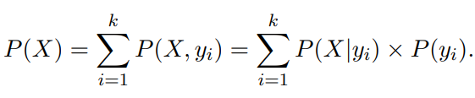
Bayes Theorem
Bayes theorem:
Bayes theorem provides a relationship between the conditional probabilities P(Y |X) and P(X|Y ).
The denominator in above Equation involves the marginal probability of X, which can also be represented as

Slide 46
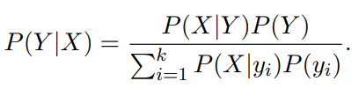
Bayes Theorem
Using the previous expression for P(X), we can obtain the following equation for P(Y |X) solely in terms of P(X|Y ) and P(Y ):

Slide 47
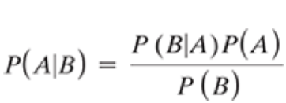
Navie Bayes
It is a probabilistic classifier, which means it predicts on the basis of the probability of an object. Some popular examples of Naive Bayes Algorithm are spam filtration, Sentimental analysis, and classifying articles.
Bayes’ theorem is also known as Bayes’ Rule or Bayes’ law, which is used to determine the probability of a hypothesis with prior knowledge. It depends on the conditional probability.
Where, P(A|B) is Posterior probability: Probability of hypothesis A on the observed event B.
P(B|A) is Likelihood probability: Probability of the evidence given that the probability of a hypothesis is true.
P(A) is Prior Probability: Probability of hypothesis before observing the evidence.
P(B) is Marginal Probability: Probability of Evidence.

Slide 48
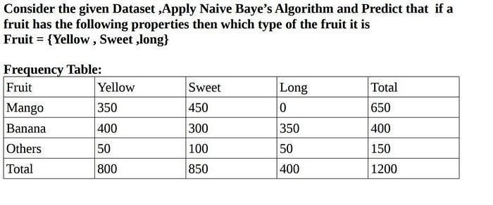
Navie Bayes

Slide 49
Navie Bayes
Solution: P(A|B) = (P(B|A) * P(A) )/ P(B)
Mango: P(X | Mango) = P(Ye | Yellow ) * P(Sweet | Mango) * P(Long | Mango)
a)P(Yellow | Mango) = (P(Mango | Yellow) * P(Yellow) )/ P (Mango) = ((350/800) * (800/1200)) / (650/1200)
P(Yellow | Mango)= 0.53 →1
1.b)P(Sweet | Mango) = (P(Sweet | Mango) * P(Sweet) )/ P (Mango) = ((450/850) * (850/1200)) / (650/1200)
P(Sweet | Mango)= 0.69 → 2
c)P(Long | Mango) = (P(Long | Mango) * P(Long) )/ P (Mango) = ((0/650) * (400/1200)) / (800/1200)
P(Long | Mango)= 0 → 3
On multiplying eq 1,2,3 ==> P(X | Mango) = 0.53 * 0.69 * 0
P(X | Mango) = 0

Slide 50
Navie Bayes
2. Banana: P(X | Banana) = P(Yellow | Banana) * P(Sweet | Banana) * P(Long | Banana)
2.a) P(Yellow | Banana) = (P( Banana | Yellow ) * P(Yellow) )/ P (Banana) = ((400/800) * (800/1200)) / (400/1200)
P(Yellow | Banana) = 1 → 4
2.b) P(Sweet | Banana) = (P( Banana | Sweet) * P(Sweet) )/ P (Banana) = ((300/850) * (850/1200)) / (400/1200)
P(Sweet | Banana) = .75→ 5
2.c)P(Long | Banana) = (P( Banana | Yellow ) * P(Long) )/ P (Banana) = ((350/400) * (400/1200)) / (400/1200)
P(Long | Banana) = 0.875 → 6
On multiplying eq 4,5,6 ==> P(X | Banana) = 1 * .75 * 0.875
P(X | Banana) = 0.6562

Slide 51
Navie Bayes
3. Others: P(X | Others) = P(Yellow | Others) * P(Sweet | Others) * P(Long | Others)
3.a) P(Yellow | Others) = (P( Others| Yellow ) * P(Yellow) )/ P (Others) = ((50/800) * (800/1200)) / (150/1200)
P(Yellow | Others) = 0.34→ 7
3.b) P(Sweet | Others) = (P( Others| Sweet ) * P(Sweet) )/ P (Others) = ((100/850) * (850/1200)) / (150/1200)
P(Sweet | Others) = 0.67 → 8
3.c) P(Long | Others) = (P( Others| Long) * P(Long) )/ P (Others) = ((50/400) * (400/1200)) / (150/1200)
P(Long | Others) = 0.34 → 9
On multiplying eq 7,8,9 ==> P(X | Others) = 0.34 * 0.67* 0.34
P(X | Others) = 0.07742
So finally from P(X | Mango) == 0 , P(X | Banana) == 0.65 and P(X| Others) == 0.07742.
We can conclude Fruit{Yellow,Sweet,Long} is Banana.

Slide 52
Navie Bayes
The posterior probability can be calculated by first, constructing a frequency table for each attribute against the target.
Then, transforming the frequency tables to likelihood tables and finally use the Naive Bayesian equation to calculate the posterior probability for each class.
The class with the highest posterior probability is the outcome of prediction.

Slide 53
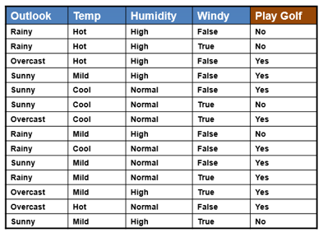
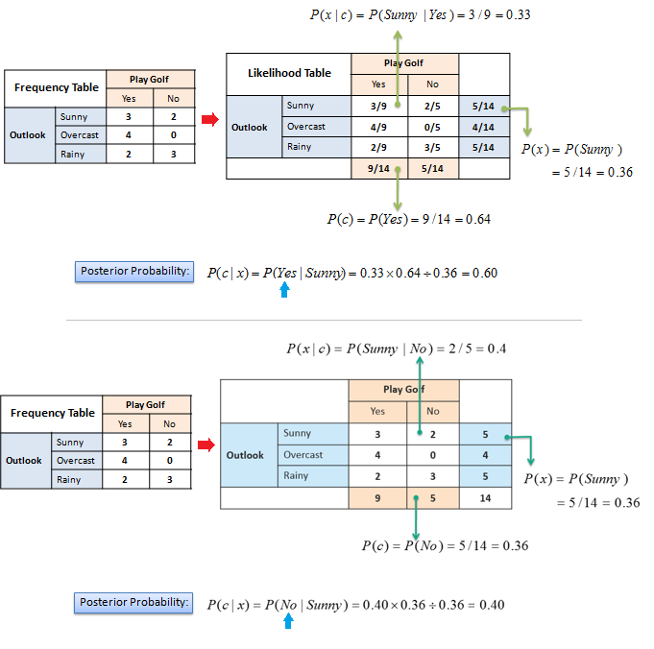
Navie Bayes

Slide 54
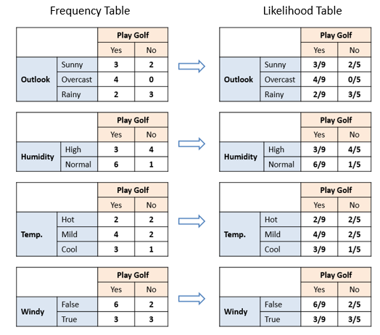
Navie Bayes

Slide 55
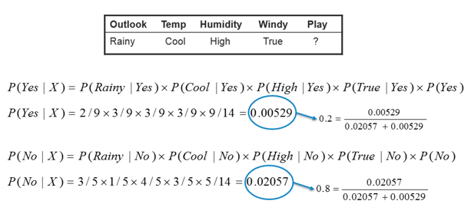
Navie Bayes
In this example we have 4 inputs (predictors). The final posterior probabilities can be standardized between 0 and 1.

Slide 56
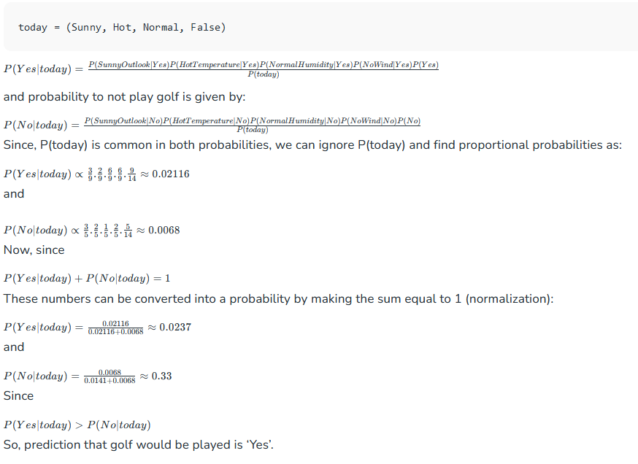
Navie Bayes

Slide 57
Navie Bayes
Now suppose you want to calculate the probability of playing when the weather is overcast.
Probability of playing:
P(Yes | Overcast) = P(Overcast | Yes) P(Yes) / P (Overcast) .....................(1)
Calculate Prior Probabilities: P(Overcast) = 4/14 = 0.29 , P(Yes)= 9/14 = 0.64
Calculate Posterior Probabilities: P(Overcast |Yes) = 4/9 = 0.44
Put Prior and Posterior probabilities in equation (1)
P (Yes | Overcast) = 0.44 * 0.64 / 0.29 = 0.98(Higher)
Similarly, you can calculate the probability of not playing:

Slide 58
Navie Bayes
Probability of not playing:
P(No | Overcast) = P(Overcast | No) P(No) / P (Overcast) .....................(2)
Calculate Prior Probabilities: P(Overcast) = 4/14 = 0.29, P(No)= 5/14 = 0.36
Calculate Posterior Probabilities: P(Overcast |No) = 0/9 = 0
Put Prior and Posterior probabilities in equation (2)
P (No | Overcast) = 0 * 0.36 / 0.29 = 0
The probability of a 'Yes' class is higher.
So you can determine here if the weather is overcast than players will play the sport.

Slide 59
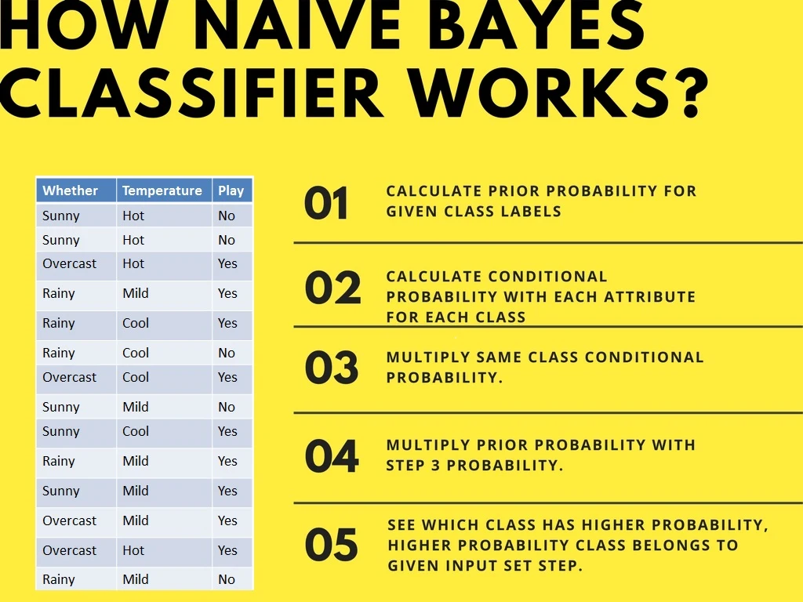
Navie Bayes
Second Approach (In case of multiple features)

Slide 60
Navie Bayes
Second Approach (In case of multiple features)
Now suppose you want to calculate the probability of playing when the weather is overcast, and the temperature is mild.
Probability of playing: P(Play= Yes | Weather=Overcast, Temp=Mild) = P(Weather=Overcast, Temp=Mild | Play= Yes)P(Play=Yes) ..........(1)
P(Weather=Overcast, Temp=Mild | Play= Yes)= P(Overcast |Yes) P(Mild |Yes) ………..(2)
Calculate Prior Probabilities: P(Yes)= 9/14 = 0.64
Calculate Posterior Probabilities: P(Overcast |Yes) = 4/9 = 0.44 P(Mild |Yes) = 4/9 = 0.44
Put Posterior probabilities in equation (2) P(Weather=Overcast, Temp=Mild | Play= Yes) = 0.44 * 0.44 = 0.1936(Higher)
Put Prior and Posterior probabilities in equation (1) P(Play= Yes | Weather=Overcast, Temp=Mild) = 0.1936*0.64 = 0.124
Similarly, you can calculate the probability of not playing:

Slide 61
Navie Bayes
Probability of not playing:
P(Play= No | Weather=Overcast, Temp=Mild) = P(Weather=Overcast, Temp=Mild | Play= No)P(Play=No) ..........(3)
P(Weather=Overcast, Temp=Mild | Play= No)= P(Weather=Overcast |Play=No) P(Temp=Mild | Play=No) ………..(4)
Calculate Prior Probabilities: P(No)= 5/14 = 0.36
Calculate Posterior Probabilities: P(Weather=Overcast |Play=No) = 0/9 = 0 P(Temp=Mild | Play=No)=2/5=0.4
Put posterior probabilities in equation (4) P(Weather=Overcast, Temp=Mild | Play= No) = 0 * 0.4= 0
Put prior and posterior probabilities in equation (3) P(Play= No | Weather=Overcast, Temp=Mild) = 0*0.36=0
The probability of a 'Yes' class is higher.
So you can say here that if the weather is overcast than players will play the sport.

Slide 62
Navie Bayes
Robust to isolated noise points
Handle missing values by ignoring the instance during probability estimate calculations
Robust to irrelevant attributes
Redundant and correlated attributes will violate class conditional assumption
Use other techniques such as Bayesian Belief Networks (BBN)

Slide 63
Bayesian Belief Networks
Provides graphical representation of probabilistic relationships among a set of random variables
Consists of:
A directed acyclic graph (dag)
Node corresponds to a variable
Arc corresponds to dependence relationship between a pair of variables
A probability table associating each node to its immediate parent

Slide 64
Conditional Independence
D is parent of C
A is child of C
B is descendant of D
D is ancestor of A
A node in a Bayesian network is conditionally independent of all of its nondescendants, if its parents are known

Slide 65
Probability Tables
If X does not have any parents, table contains prior probability P(X)
If X has only one parent (Y), table contains conditional probability P(X|Y)
If X has multiple parents (Y₁, Y₂,…, Y_{k}), table contains conditional probability P(X|Y₁, Y₂,…, Y_{k})

Slide 66
Example of Bayesian Belief Network

Slide 67
Example of Inferencing using BBN
Given: X = (E=No, D=Yes, CP=Yes, BP=High)
Compute P(HD|E,D,CP,BP)?
P(HD=Yes| E=No,D=Yes) = 0.55 P(CP=Yes| HD=Yes) = 0.8 P(BP=High| HD=Yes) = 0.85
P(HD=Yes|E=No,D=Yes,CP=Yes,BP=High) ∝ 0.55 × 0.8 × 0.85 = 0.374
P(HD=No| E=No,D=Yes) = 0.45 P(CP=Yes| HD=No) = 0.01 P(BP=High| HD=No) = 0.2
P(HD=No|E=No,D=Yes,CP=Yes,BP=High) ∝ 0.45 × 0.01 × 0.2 = 0.0009
Classify X as Yes

Slide 68
Logistic Regression

Slide 69
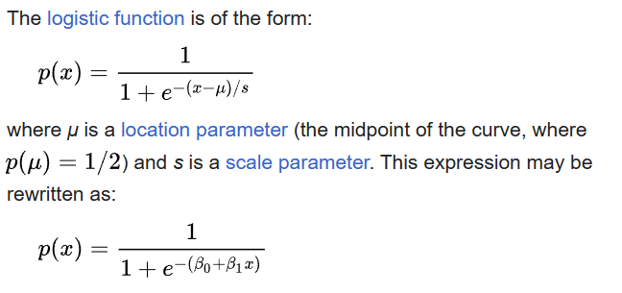
Logistic Model
Logistic model (or logit model) is a statistical model that models the probability of an event taking place by having the log-odds for the event be a linear combination of one or more independent variables.

Slide 70
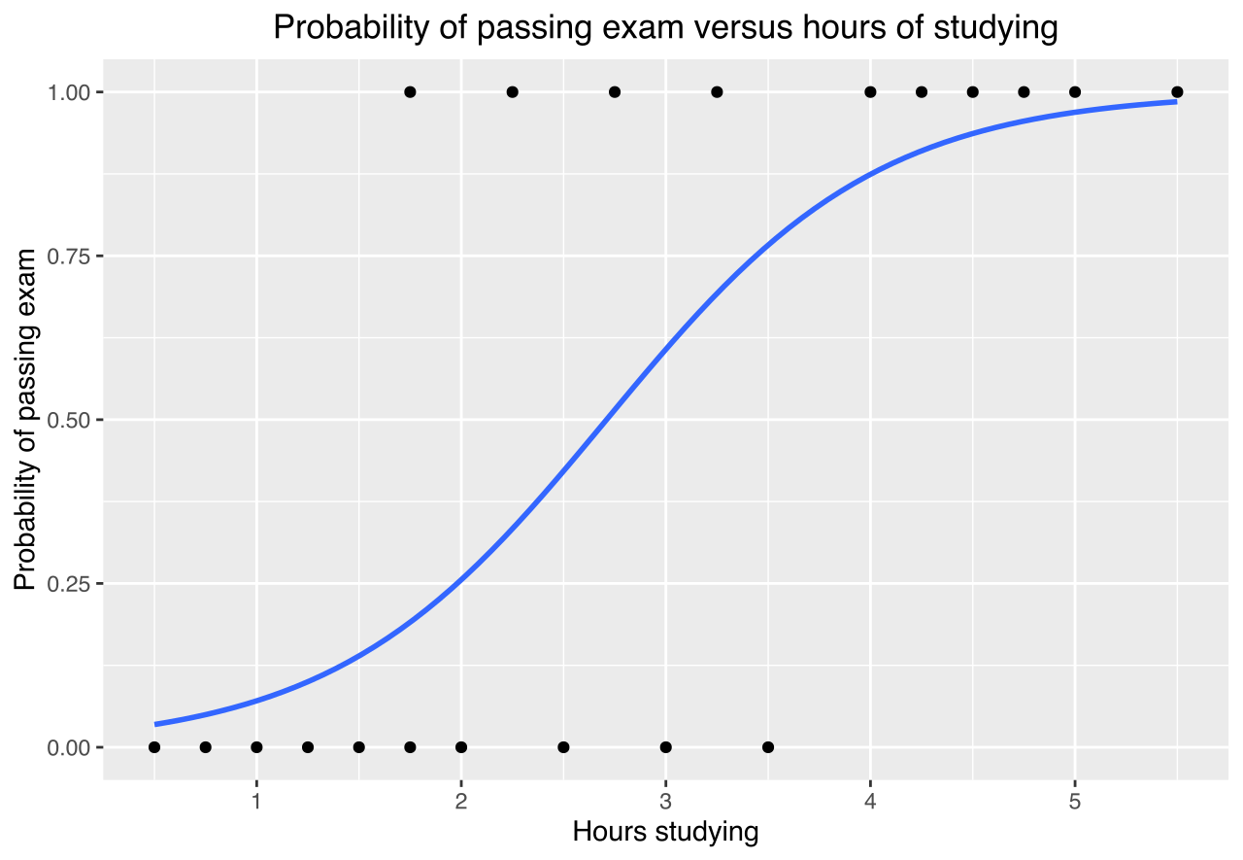
An example curve
Example graph of a logistic regression curve fitted to data. The curve shows the probability of passing an exam (binary dependent variable) versus hours studying (scalar independent variable).

Slide 71

Logistic Regression
Logistic regression is a probabilistic discriminative model that directly estimates the odds of a data instance a using its attribute values.
Basic idea is to use linear predictor, z = wT x + b, for representing the odds of x as follows:
where w and b are the parameters of the model and aT denotes the transpose of a vector a. Note that if wT x + b > 0, then x belongs to class 1 since its odds is greater than 1. Otherwise, x belongs to class 0.

Slide 72


Cont…
Since P(y = 0|x) + P(y = 1|x) = 1, we can re-write
This can be further simplified to express P(y = 1|x) as a function of z.
where the function σ(.) is known as the logistic or sigmoid function

Slide 73
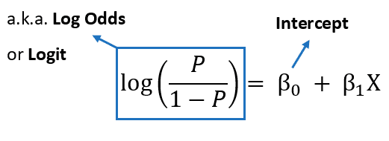


Logistic Regression as a Generalized Linear Model
Logistic regression belongs to a broader family of statistical regression models, known as generalized linear models (GLM).
Even though logistic regression has relationships with regression models, it is a classification model since the computed posterior probabilities are eventually used to determine the class label of a data instance.

Slide 74

Learning Model Parameters
The parameters of logistic regression, (w, b), are estimated during training using a statistical approach known as the maximum likelihood estimation (MLE) method.

Slide 75
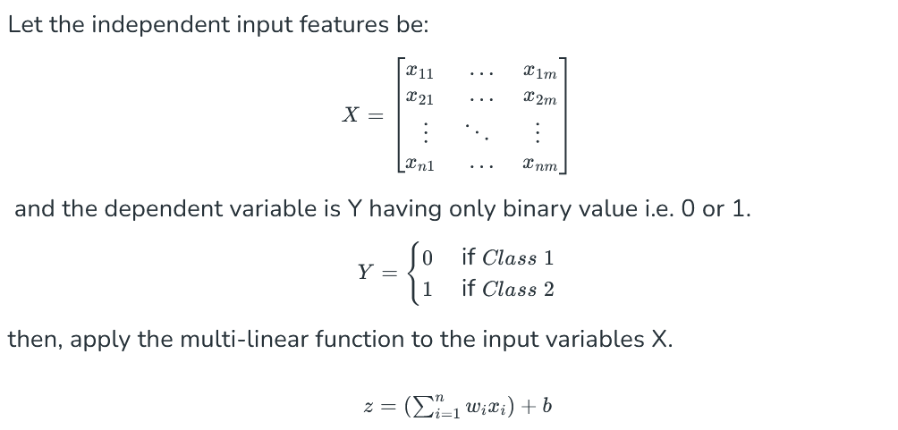
How does Logistic regression work

Slide 76
Cont…
Types of Logistic Regression
On the basis of the categories, Logistic Regression can be classified into three types:
Binomial: In binomial Logistic regression, there can be only two possible types of the dependent variables, such as 0 or 1, Pass or Fail, etc.
Multinomial: In multinomial Logistic regression, there can be 3 or more possible unordered types of the dependent variable, such as “cat”, “dogs”, or “sheep”
Ordinal: In ordinal Logistic regression, there can be 3 or more possible ordered types of dependent variables, such as “low”, “Medium”, or “High”.

Slide 77
Cont…
Assumptions of Logistic Regression
The assumption include:
Independent observations: Each observation is independent of the other. meaning there is no correlation between any input variables.
Binary dependent variables: It takes the assumption that the dependent variable must be binary or dichotomous, meaning it can take only two values.
For more than two categories SoftMax functions are used.
Linearity relationship between independent variables and log odds: The relationship between the independent variables and the log odds of the dependent variable should be linear.
No outliers: There should be no outliers in the dataset.
Large sample size: The sample size is sufficiently large

Slide 78
Characteristics of LR
Discriminative model for classification.
The learned parameters of logistic regression can be analyzed to understand the relationships between attributes and class labels.
Can work more robustly even in high-dimensional settings
Can handle irrelevant attributes
Cannot handle data instances with missing values

Slide 79
Ensemble Methods
In the realm of machine learning we can categorize models into two fundamental groups: Base Models and Ensemble Models.
Base Models: These are individual machine learning models that are used independently to make predictions.
For example, decision trees, logistic regression, K-nearest neighbors (KNN), Support Vector Machines (SVM), linear regression, and so on.
Base models are often the building blocks of ensemble models.
Ensemble models: The idea behind of ensemble models is to combine many weak learners( simple “building block” models) in order to obtain a strong learner (a single and potentially very powerful model).

Slide 80
Ensemble Methods
Ensemble techniques in machine learning function much like:
seeking advice from multiple sources before making a significant decision, such as purchasing a car.
Technically : Construct a set of base classifiers learned from the training data
Predict class label of test records by combining the predictions made by multiple classifiers (e.g., by taking majority vote)

Slide 81
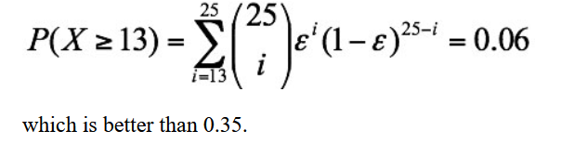
Ensemble Methods
Suppose there are 25 base classifiers. Each classifier has error rate, ε = 0.35
Assume errors made by classifiers are uncorrelated
Probability that the ensemble classifier makes a wrong prediction: Probability of having more than half of base classifiers are being wrong ..
Necessary Conditions for Ensemble Methods:
Ensemble Methods work better than a single base classifier if:
All base classifiers are independent of each other
All base classifiers perform better than random guessing (error rate < 0.5 for binary classification)

Slide 82
Rationale for Ensemble Learning
Ensemble Methods work best with unstable base classifiers.
Unstable : overfitting – having high variance.
Classifiers that are sensitive to minor perturbations (noise) in training set, due to high model complexity.
Examples: Unpruned decision trees, ANNs, KNN with small k…

Slide 83

Bias-Variance Decomposition
Analogous problem of reaching a target y by firing projectiles from x (regression problem)
For classification, the generalization error of model $m$ can be given by:
$$gen.error\left(m\right)=c_{1}+bias\left(m\right)+c_{2}×variance(m)$$

Slide 84
Bias-Variance Trade-off and Overfitting
Overfitting
Underfitting
Ensemble methods try to reduce the variance of complex models (with low bias) by aggregating responses of multiple base classifiers

Slide 85
General Approach of Ensemble Learning
Using majority vote or weighted majority vote
(weighted according to their accuracy or relevance)

Slide 86
Constructing Ensemble Classifiers
By manipulating training set
Example: bagging, boosting, random forests
By manipulating input features
Example: random forests
By manipulating class labels
Example: error-correcting output coding
By manipulating learning algorithm
Example: injecting randomness in the initial weights of ANN

Slide 87
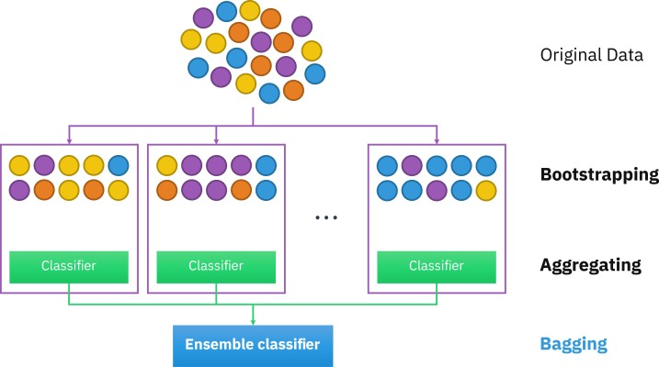
Bagging (Bootstrap AGGregatING)
Bootstrap method is used to create multiple subsets of training data set and then train multiple base models separately on these bootstrapped training set to get different predictions from these base models.
The final prediction is obtained by averaging or voting on the predictions from these base models.

Slide 88
Bagging (Bootstrap AGGregatING)
Bootstrap sampling: sampling with replacement
Build classifier on each bootstrap sample
Probability of a training instance being selected in a bootstrap sample is:
1 – (1 - 1/n)^{n} (n: number of training instances)
~0.632 when n is large

Slide 89
Bagging Algorithm

Slide 90
Bagging Example
Consider 1-dimensional data set:
Classifier is a decision stump (decision tree of size 1)
Decision rule: x ≤ k versus x > k
Split point k is chosen based on entropy
x ≤ k
True
False
y_{left}
y_{right}

Slide 91
Bagging Example

Slide 92
Bagging Example

Slide 93
Bagging Example
Summary of Trained Decision Stumps:

Slide 94
Bagging Example
Use majority vote (sign of sum of predictions) to determine class of ensemble classifier
Bagging can also increase the complexity (representation capacity) of simple classifiers such as decision stumps
Predicted Class

Slide 95
Boosting
Boosting uses the entire training data set in a sequential manner to improve the performance of weak learners.
First, using the whole training data set to fit on a weak leaner.
Then, according to the prediction results to adjust the weight of each observation in the training data set.
Giving lower weights to those were classified correctly, while giving higher weights to those were classified incorrectly.
Fitting a new weak learner on this modified data set.
The sequential process of adjusting weights and predictions continues until a stopping criterion is reached.
The final prediction is a weighted result of all weak learners.

Slide 96
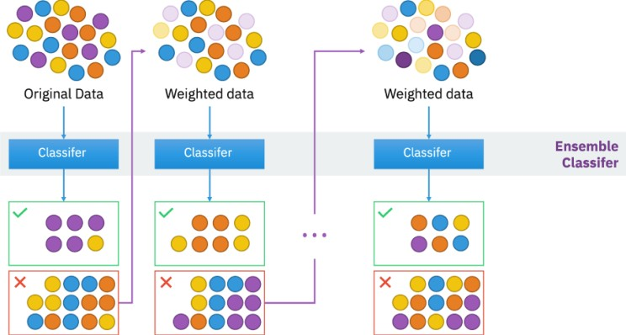
Boosting
Examples of well-established boosting models in machine learning include AdaBoost, Gradient Boosting, and XGBoost.

Slide 97
Boosting
An iterative procedure to adaptively change distribution of training data by focusing more on previously misclassified records
Initially, all N records are assigned equal weights (for being selected for training)
Unlike bagging, weights may change at the end of each boosting round
Records that are wrongly classified will have their weights increased in the next round.
Records that are classified correctly will have their weights decreased in the next round
Example 4 is hard to classify
Its weight is increased, therefore it is more likely to be chosen again in subsequent rounds

Slide 98
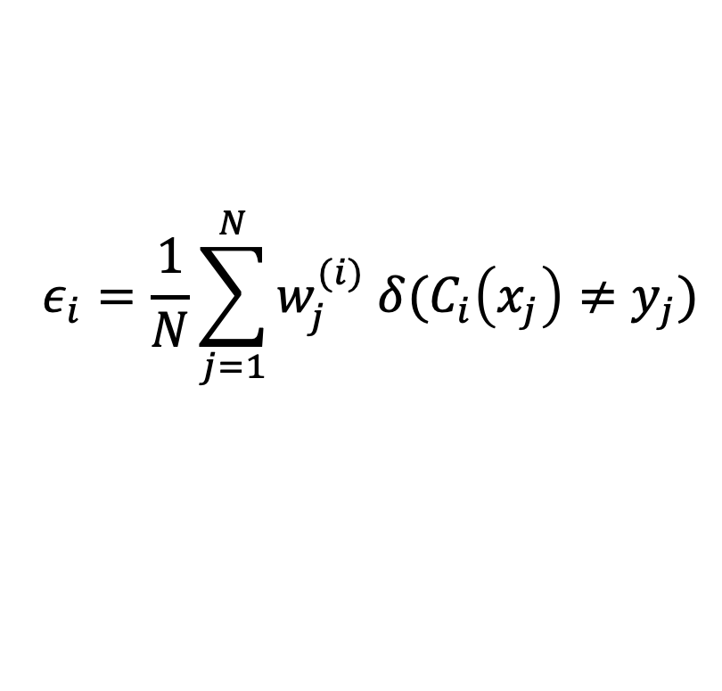
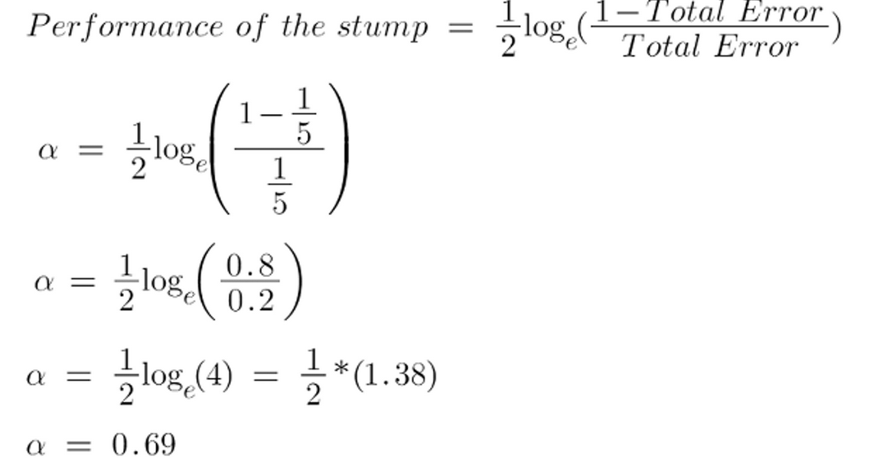
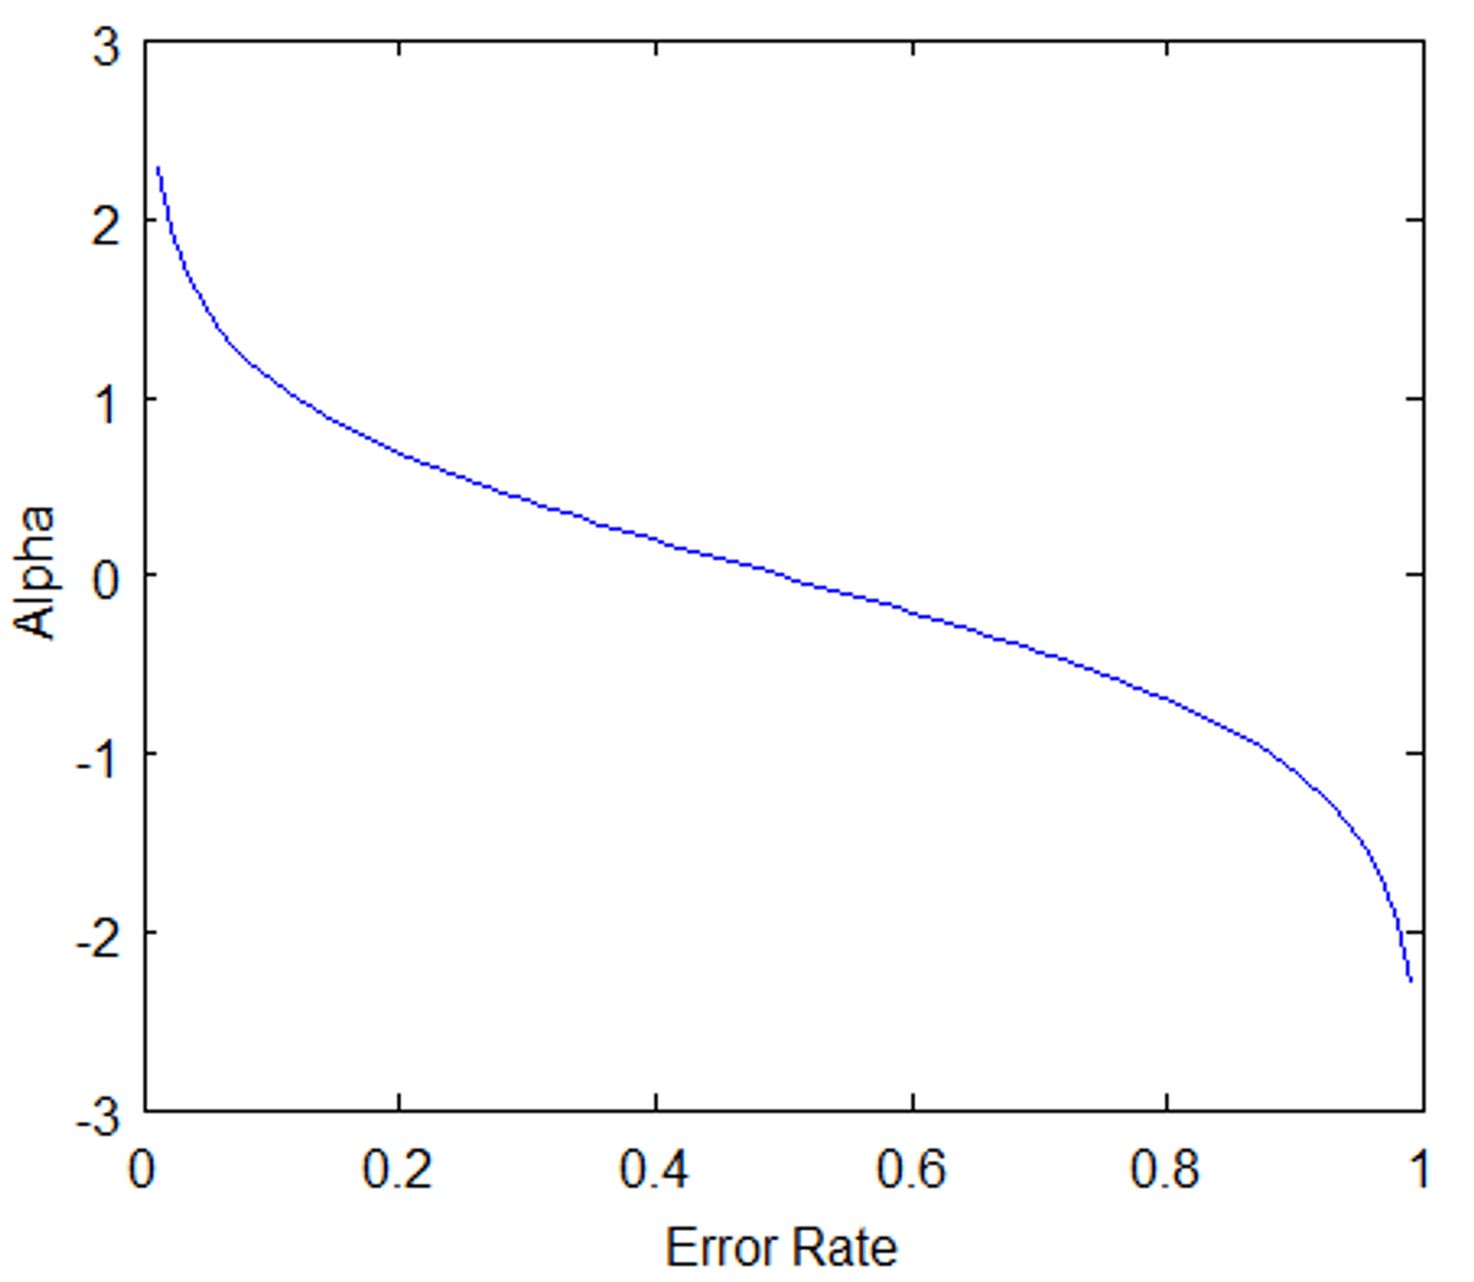
AdaBoost
If there is one incorrect output in our dataset, thus our total error is 1/5, and the alpha (performance of the stump) is:
Base classifiers: C₁, C₂, …, C_{T}
Error rate of a base classifier:
Importance of a classifier:

Slide 99
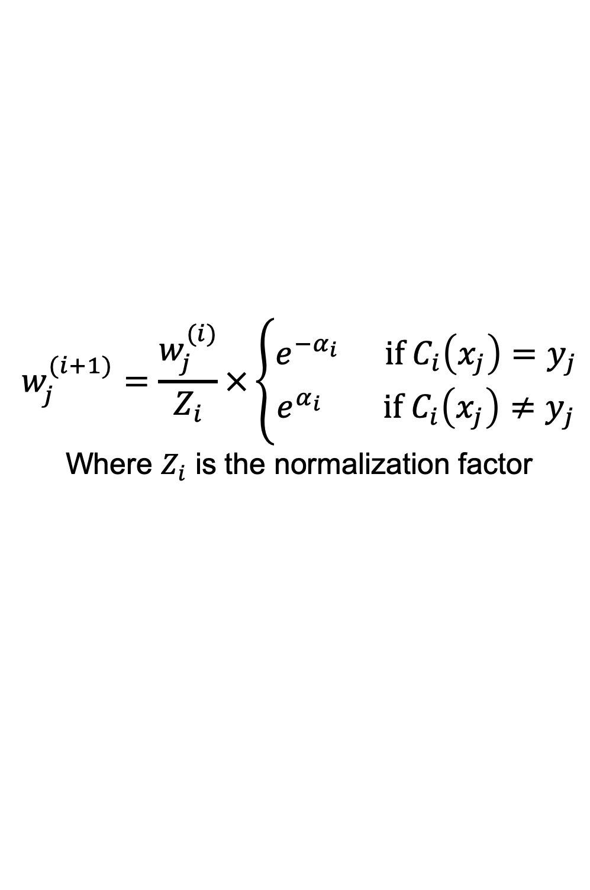
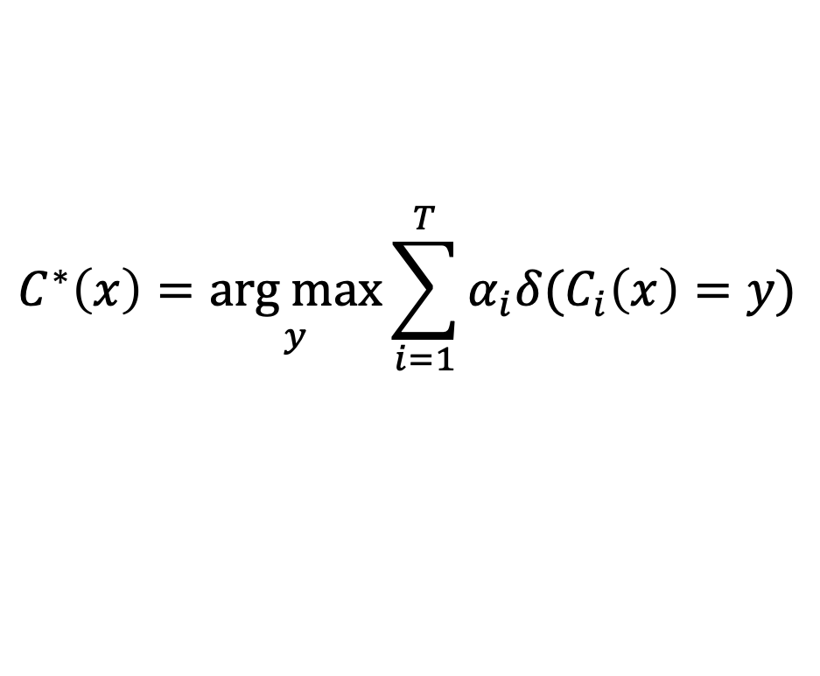
AdaBoost Algorithm
Weight update:
If any intermediate rounds produce error rate higher than 50%, the weights are reverted back to 1/n and the resampling procedure is repeated
Classification:
When the sample is successfully identified, the amount of, say, (alpha) will be negative.
When the sample is misclassified, the amount of (alpha) will be positive.

Slide 100
AdaBoost Algorithm

Slide 101
AdaBoost Example
Consider 1-dimensional data set:
Classifier is a decision stump
Decision rule: x ≤ k versus x > k
Split point k is chosen based on entropy
x ≤ k
True
False
y_{left}
y_{right}

Slide 102
AdaBoost Example
Training sets for the first 3 boosting rounds:
Summary:

Slide 103
AdaBoost Example
Weights
Classification
Predicted Class

Slide 104
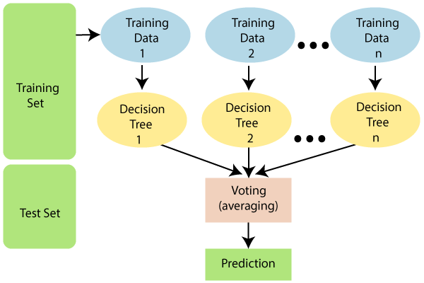
Random Forest Algorithm
Construct an ensemble of decision trees by manipulating training set as well as features – (process of combining multiple classifiers to solve a complex problem and to improve the performance of the model.)
Use bootstrap sample to train every decision tree (similar to Bagging)
Use the following tree induction algorithm:
At every internal node of decision tree, randomly sample p attributes for selecting split criterion
Repeat this procedure until all leaves are pure (unpruned tree)

Slide 105
Gradient Boosting
Constructs a series of models
Models can be any predictive model that has a differentiable loss function (MSE)
Commonly, trees are the chosen model
XGboost (extreme gradient boosting) is a popular package because of its impressive performance
For the steepest descent method, the search direction is given by dk = −∇f (xk).
Boosting can be viewed as optimizing the loss function by iterative functional gradient descent.
Implementations of various boosted algorithms are available in Python, R, Matlab, and more.

Slide 106

Gradient Boosting Algorithm
Step 1:
Let’s assume X, and Y are the input and target having N samples. Our goal is to learn the function f(x) that maps the input features X to the target variables y. It is boosted trees i.e the sum of trees.
The loss function is the difference between the actual and the predicted variables.
Step 2: We want to minimize the loss function L(f) with respect to f.

Slide 107
Gradient Boosting Algorithm
Step 3: Steepest Descent (dk = −∇f (xk).
Step 4: Solution: The gradient Similarly for M trees:

Slide 108
Numerical Problem on Logistic
Given the class, how can we calculate the probability of pass for the student who studied 33 hours?
At least how many hours student should study that makes him to pass the course with probability of > 95%
Assume the model suggested by the optimizer for odds of passing the course is : log(odds) = -64+2*hours
Hours Study | Pass (1) / Fail (0)
29 | 0
15 | 0
33 | 1
28 | 1
39 | 1

Slide 109
Numerical Problem on Adaboost
CGPA | InteractiveNess | Practical Knowledge | Comm skills | Job profile
>=9 | Yes | Good | Good | Yes
<9 | N | G | Moderate | Y
>=9 | N | Avg | M | N
<9 | N | Avg | G | N
>=9 | Y | G | M | Y
>=9 | Y | G | M | Y
Consider a training dataset of 6 data instances. Use 4 decision stumps for each of the 4 attributes. Apply adaboost algorithm and classify the dataset with job offer as target attribute?

Slide 110
Numerical Problem on Adaboost
Step 1: Initial Weight assigned to each item is 1/6
Step 2: Iterate for each weak classifier (due to 4 stumps – weak learners)
A. Train the decision stump HCGPA with a random bootstrap sample from training dataset.
B. Compute the weighted error
C. Compute the weight of each weak classifier
D. calculate the normalization factor ZCGPA
E. Update the weights of all data instances
Step 3: Compute the final predicted value for each data instance

Slide 111
References:
Introduction to Data Mining ,Pang-Ning Tan, Michael Steinbach, Vipin Kumar,2nd edition, 2019,Pearson , ISBN-10-9332571406, ISBN-13 -978-9332571402
Machine Learning ,Tom M. Mitchell, Indian Edition, 2013, McGraw Hill Education, ISBN – 10 – 1259096955
Jiawei Han and Micheline, Kamber: Data Mining – Concepts and Techniques, 2nd Edition, Morgan Kaufmann, 2006, ISBN 1-55860-901-6
Thank you all

